Slide 1
A Seminar On Blockchain-Based Secure Key Management for Mobile Edge Computing
Team Details:
P Rithvik (20EG105635)
G Mani Akshaya (20EG105649)
K Sai Lokesh (20EG105705)
Project Supervisor
Mrs. K Rashmi
Assistant Professor

Slide 2
Introduction
Mobile edge computing (MEC) is now recognized as a key edge technology for supporting low latency and high bandwidth mobile services with shared resources
Many of these services will involve transferring private and sensitive information of the users among a group of communicating devices, which give rise to major security concerns. It is worthwhile pointing out that all participants are assumed to be untrusted in the MEC network. Key management is an essential component for providing security in any network .
In a MEC infrastructure, the security of key management should allow nodes to establish pairwise keys in order to facilitate secure communication between the nodes in the network . The mobility of devices brings a new challenge for ensuring group communication in a MEC network, i.e., how to transfer keys to members moving from one subnetwork (group) to another while still remaining in communication. Since the members of the new subnetwork do not recognize the newly joined member, an additional overhead will be incurred for key generation, key distribution and key storage

Slide 3
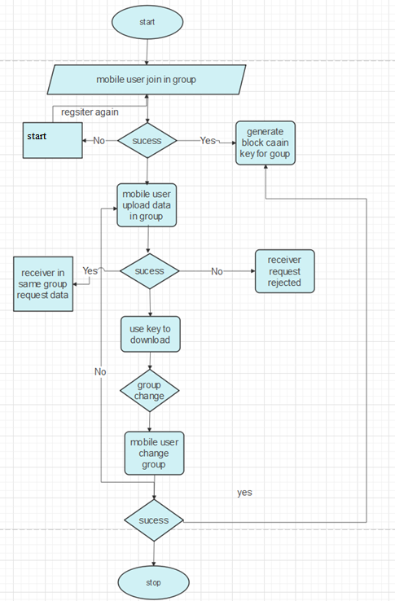
Concept Tree

Slide 4
Literature
Author(s) | Strategies | Advantages | Disadvantages
R. Roman, J. Lopez, and M. Mambo | Edge paradigms should consider the advances in other paradigms. | The main goal of this study is to holistically analyze the security threats, challenges, and mechanisms inherent in all edge paradigms, while highlighting potential synergies and venues of collaboration | For various reasons, the cloud computing paradigm is unable to meet certain requirements (e.g. low latency and jitter, context awareness, mobility support).
M. S. Yousefpoor and H. Barati | Dynamic key management systems in wireless sensor networks | We review dynamic key management systems in wireless sensor networks and introduce some evaluation criteria in key management systems. Also, we categorize dynamic key management schemes based on the type of keys, key distribution mechanisms | Limitations are the physical size and low energy level of sensor nodes.

Slide 5
Literature(cont..)
Author(s) | Method | Advantages | Disadvantages
C. K. Wong, M. Gouda, and S. S. Lam, | Logical Key Hierarchy | Reduced number of messages for key updates(log(n) messages, where n is the number of group members). | Dependence on a common Temporary Encryption Key(TEK) for all group members.
C. Esposito, M. Ficco, A. Castiglione, F. Palmieri, | standard cells and a structured physical design approach | n this work, we propose a series of solutions and methods to achieve confidentiality with end-to-end guarantees, by using group-based keys within the context of a clustered and distributed key management framework | Secure communications among the IoT nodes are strongly needed due to the use of wireless technologies that are easy to eavesdrop, in order to steal valuable information

Slide 6
Problem Statement
Mobile edge computing (MEC) is now recognized as a key edge technology for supporting low latency and high bandwidth mobile services with shared resources . Many of these services will involve transferring private and sensitive information of the users among a group of communicating devices, which give rise to major security concerns researchers have shown the existing vulnerability and threats in MEC. It is worthwhile pointing out that all participants are assumed to be untrusted in the MEC network.

Slide 7
Problem Illustration
The mobility of the mobile device may lead to a high frequency in the update and the distribution of the communication key pairs for mobile devices. Whenever the device enters, leaves or moves to a new subnetwork, the key manager updates the key for the group members to ensure the security of the group communication
In the sub network, each sub network can be considered as a group Gi and each edge between two sub networks can be viewed as an edge Ei, where i 1, i Z. Specifically, Ei is a set of edges in partition Ti. All possible subtree partitioning sets of the tree network T are represented as T= T1 T2 Ti such that Ti =(GiEi) and Gi GGi = Ei E. Hence,we can consider the communication among the members of a sub network in the subtree Ti as a group communication.

Slide 8
Proposed Method
The emerging blockchain technique offers the potential to build a trusted, fair-minded and decentralized environment for key management scheme in wireless mobile edge networks.
Besides, keeping private keys locally and storing public keys in the blockchain can reduce the overhead of rekeying process. Because when users move into a new group, their records (i.e., public keys) can be traced in the previous blocks in local or higher hierarchical blockchain,
so that their identities can be verified quickly.
Meanwhile, only if the quick verification is failed, the users need to generate a new key pair (i.e., rekeying) which will be appended to the blockchain. Moreover, the key pair of users will be invalid once they generate a new one, which can reduce the overhead of backward and forward secrecy in the rekeying process.

Slide 9
Proposed Method Illustration
This paper aims to find an optimized partition of the tree network T = Ti1 Ti2 Tii of T, so that the overall overheads of the corresponding groups G= Gi1 Gi2 Gii are minimized, and then apply the block chain technique in the proposed scheme to ensure its security. The objective of our optimization problem is to minimize the overall overheads

Slide 10
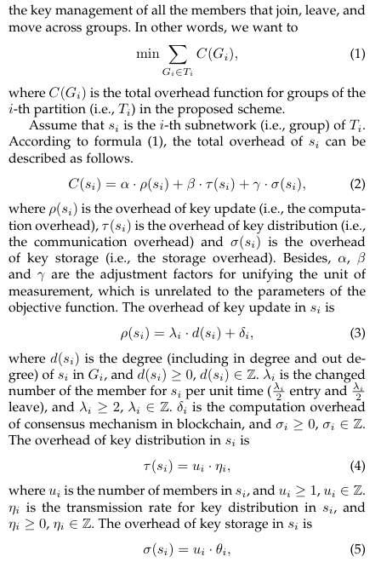
Parameter

Slide 11
Experiment Environment
Software Requirements:
Operating System - Windows XP
Coding Language - Java/J2EE(JSP,Servlet)
Front End - J2EE
Back End - MySQL

Slide 12
Project Status
S.No | Functionality | Status (Completed /in-progress/Not started)
1 | Literature survey | Completed
2 | Design Phase | Completed
3 | Coding Started web page design | Started
4 | Logic implementation | pending

Slide 13
References
[1] S. Yi, Z. Qin, and Q. Li, “Security and privacy issues of fog com puting: A survey,” in International conference on wireless algorithms, systems, and applications. Springer, 2015, pp. 685–695.
[2] M. S. Yousefpoor and H. Barati, “Dynamic key management algorithms in wireless sensor networks: A survey,” Computer Com munications, 2018.
[3] M.-L. Messai and H. Seba, “A survey of key management schemes in multi-phase wireless sensor networks,” Computer Networks, vol. 105, pp. 60–74, 2016. [5] C. K. Wong, M. Gouda, and S. S. Lam, “Secure group communi cations using key graphs,” IEEE/ACM Transactions on Networking (TON), vol. 8, no. 1, pp. 16–30, 2000.
[4] D. Wallner, E. Harder, and R. Agee, “Key management for multi cast: Issues and architectures,” Tech. Rep., 1999.

Slide 14
THANK YOU

Slide 15
Project seminar–I Evaluation
S.No | Rubrics | Marks
1 | Concept Introduction | 4
2 | Literature and Parameter | 5
3 | Problem and Problem Illustration | 8
4 | Proposed Method and Illustration | 8
Total |  | 25

